Slide 1

Web Component Development with Servlet & JSP Technologies (EE 6)
Module-3: Implementing an MVC Design
Team Emertxe

Slide 2
Objectives
Upon completion of this module, you should be able to:
Implement the controller design using a Servlet
Implement the model design using a POJO
Implement the view design element using a JSP and the expression language(EL)
Connect the model view and controller element to implement a working MVC solution

Slide 3
Relevance
Discussion – The following questions are relevant to understanding how to develop a controller component:
How can you implement the controller?
How can you implement the model?
How can you implement the view?

Slide 4

Forwarding From a Servlet to a JSP
The mechanism used to invoke the JSP page is called forwarding. Code to perform this is shown below.
RequestDispatcher rd = request.getRequestDispatcher("view.jsp");
rd.forward(request, response);

Slide 5
Passing Data From the Servlet to JSP
ServletRequest.getAttribute(String key)
ServletRequest.setAttribute(String key, Object value)
So, if a controller servlet writes a data item into an attributed using the following code:
request.setAttribute("aValue", 99);
Then the value can be read in a JSP page using this syntax:
${aValue}

Slide 6
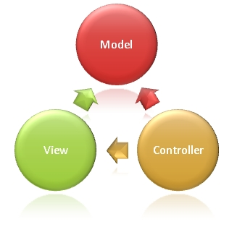
A Complete MVC Example
To create a complete MVC, we need the following:
1. Controller class
2. The model class
3. JSP page

Slide 7



Stay connected
About us: Emertxe is India’s one of the top IT finishing schools & self learning kits provider. Our primary focus is on Embedded with diversification focus on Java, Oracle and Android areas
Emertxe Information Technologies,
No-1, 9th Cross, 5th Main,
Jayamahal Extension,
Bangalore, Karnataka 560046
T: +91 80 6562 9666
E: training@emertxe.com
https://www.facebook.com/Emertxe
https://twitter.com/EmertxeTweet
https://www.slideshare.net/EmertxeSlides

Slide 8
Thank You

